Slide 1
Data Link Layer Wireless LAN
LECTURE 05

Slide 2
IEEE Std 802.11-2020 History
IEEE Std 802.11-1997 (Original Standard)
Refinement in 2003
IEEE Std 802.11-2007
802.11a, 802.11b, 802.11d, 802.11e, 802.11g, 802.11h, 802.11i, 802.11j
IEEE Std 802.11-2012
802.11k, 802.11.n, 802.11p, 802.11r, 802.11s, 802.11u, 802.11v, 802.11w, 802.11.y, 802.11z
IEEE Std 802.11-2016
802.11aa, 802.11ac, 802.11ad, 802.11ae, 802.11af

Slide 3
IEEE Std 802.11-2020 History
IEEE Std 802.11-2020
802.11ah, 802.11ai, 802.11aj, 802.11ak, 802.11aq
IEEE Std 802.11-2020 (4379 pages)
Cause 1 – Cause 25
Normative Annexes: Annex A - Annex G
Informative Annexes: Annex H - Annex Y
Recent Amendment Approval
(not included in IEEE Std 802.11-2020)
802.11ax (2021), 802.11ay, 802.11ba
IEEE Std 802.11-2024 (expected)
IEEE Std 802.11be: Enhancements for Extremely High Throughput (EHT)

Slide 4
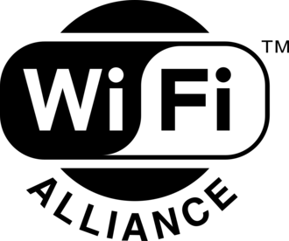

IEEE Std 802.11-2020 Wi-Fi Alliance
A non-profit organization that owns the Wi-Fi trademark.
Wi-Fi Alliance Certification
WIFI 0 (IEEE 802.11) - 2.4GHz: 1-2Mbps
WIFI 1 (IEEE 802.11b) - 2.4GHz: 1-11Mbps
WIFI 2 (IEEE 802.11a) - 5GHz: 6-54Mbps
WIFI 3 (IEEE 802.11g) - 2.4GHz: 1-54Mbps
WIFI 4 (IEEE 802.11n) - 2.4/5GHz: 72-600Mbps
IEEE Std 802.11n: Enhancements for Higher Throughput (HT)
WIFI 5 (IEEE 802.11ac) - 2.4/5GHz: 433-6933Mbps
IEEE Std 802.11ac: Enhancements for Very High Throughput (VHT) for Operation in Bands below 6 GHz
WIFI 6/6E (IEEE 802.11ax) - 2.4/5/6GHz: 574-9608Mbps
IEEE Std 802.11ax: Enhancements for High‐Efficiency (HE) WLAN
WIFI 7 (IEEE 802.11be (2024)) - 2.4/5/6GHz: 1376-46120Mbps
IEEE Std 802.11be: Enhancements for Extremely High Throughput (EHT)

Slide 5
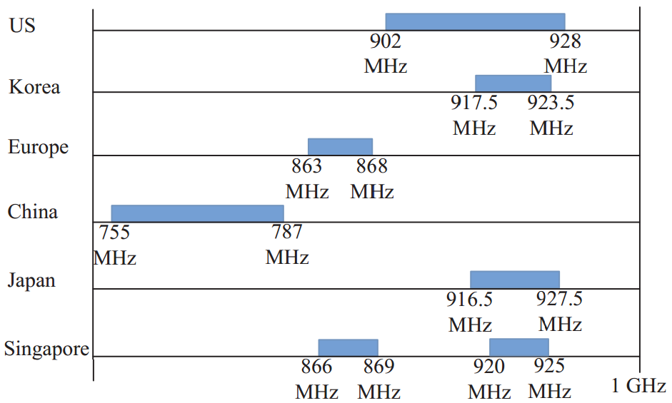
Wi-Fi channels the Sub-1GHz ISM band

Slide 6
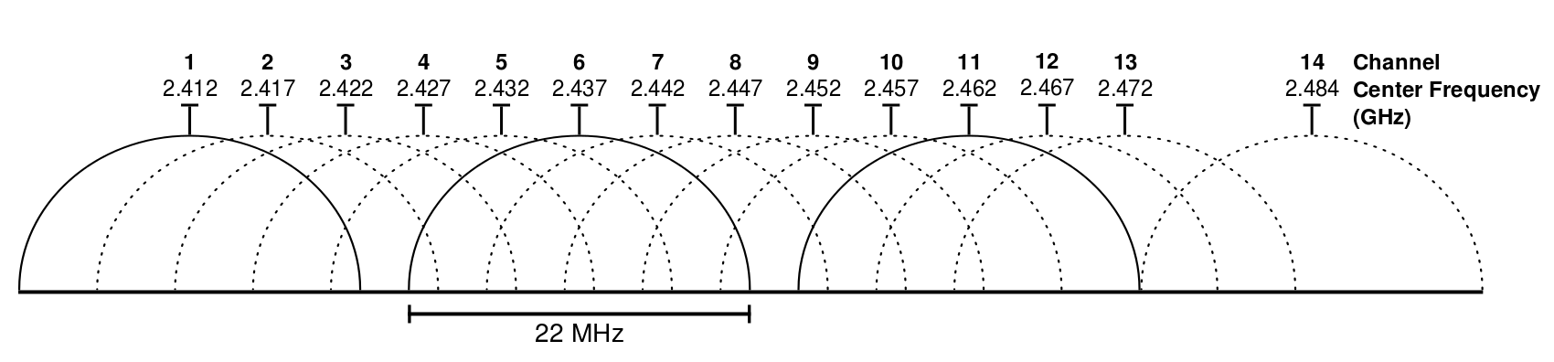
Wi-Fi channels the 2.4 GHz ISM band
https://en.wikipedia.org/wiki/2.4_GHz_radio_use
ISM Industrial, Scientific, and Medical

Slide 7
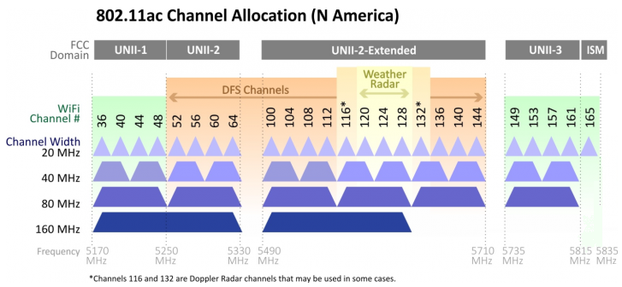
Wi-Fi channels the 5 GHz ISM band
Unlicensed –National Information Infrastructure (U-NII)
https://help.keenetic.com/hc/en-us/articles/360012060379-Available-channels-on-the-5-GHz-Wireless-network

Slide 8
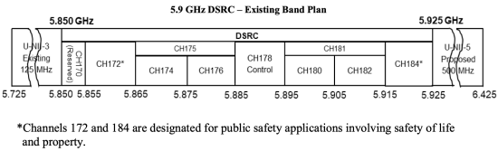
Wi-Fi channels the 5.9 GHz DSRC band
DSRC (Dedicated Short-Range Communication)

Slide 9
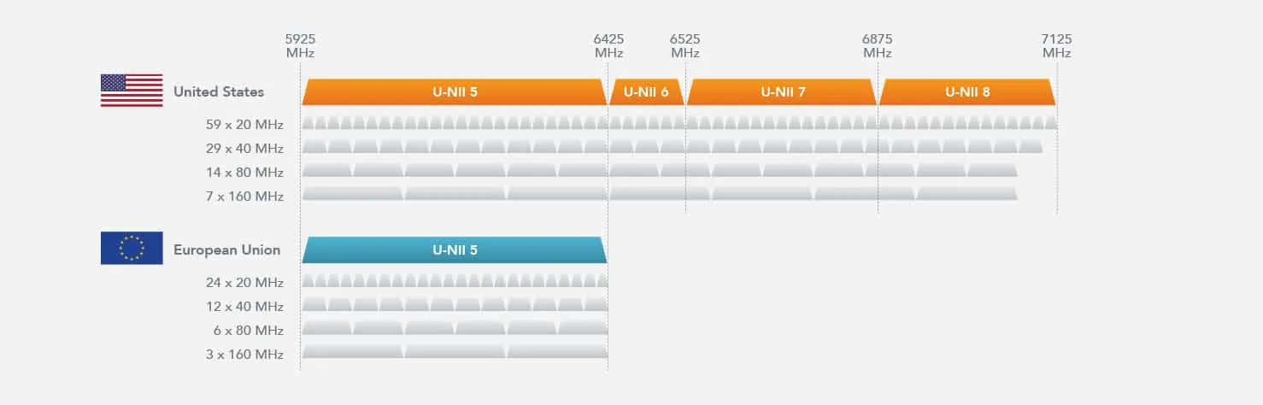
Wi-Fi channels the 6 GHz ISM band
https://www.litepoint.com/ko/wi-fi-6e/

Slide 10
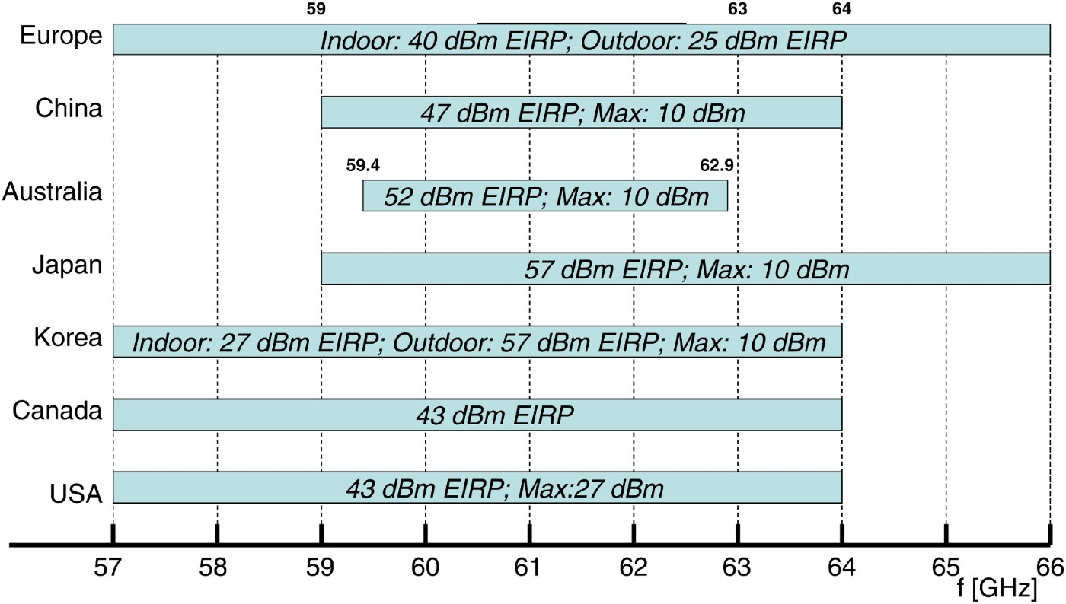
Wi-Fi channels the 60 GHz ISM band
EIRP (Effective Isotropic Radiated Power)
https://www.cambridge.org/core/journals/international-journal-of-microwave-and-wireless-technologies/article/communication-systems-operating-in-the-60-ghz-ism-band-overview/2C03F98AED97746DA97B4A88EEF55592

Slide 11
IEEE Std 802.11-2020 Frequency bands and Types of STA
Frequency bands between 1 GHz and 7.125 GHz
4.3.13 High-throughput (HT) STA (2.4GHz & 5GHz)
DSSS (IEEE 82.11-1997), HR/DSSS (IEEE 802.11b), OFDM (IEEE 802.11a), ERP-OFDM (IEEE 802.11g), HT-OFDM [MIMO OFDM] (IEEE 802.11n)
4.3.15 Very high throughput (VHT) STA
VHT-OFDM [DL MU-MIMO OFDM] (IEEE 802.11ac)
4.3.15a High-efficiency (HE) STA (2.4GHz, 5GHz, 6GHz)
HE-OFDMA [DL/UL MU-MIMO OFDMA] (IEEE 802.11ax)
(IEEE 802.11be Extremely High Throughput (EHT)
EHT-OFDMA [DL/UL MU-MIMO OFDMA]

Slide 12
IEEE Std 802.11-2020 Frequency bands and Types of STA
Frequency bands between 1 GHz and 7.125 GHz
4.3.17 STA transmission of Data frames outside the context of a BSS
IEEE 1609.0-2019 IEEE Guide for Wireless Access in Vehicular Environments (WAVE) Architecture
IEEE Std 802.11 uses the orthogonal frequency division multiplexing (OFDM) PHY (5.850 GHz to 5.925 GHz in the US, 5.855 GHz to 5.925 GHz in Europe),
IEEE 802.11p (Wireless Access in Vehicular Environments) - 5.9GHz (10MHz)
IEEE 802.11bd-2022 (Next Generation V2X) – 5.9GHz & 60GHz

Slide 13
IEEE Std 802.11-2020 Frequency bands and Types of STA
Frequency bands below 1GHz
4.3.14 Sub 1 GHz (S1G) STA (IEEE 802.11ah)
0.7/0.8/0.9 GHz
Channel Width=1,2,4,8,16MHz (1/10 of VHT)
4.3.16 Television very high throughput (TVHT) STA (IEEE 802.11af)
0.054-0.79 GHz
Basic Channel Units (BCU or TVHT_W)= 6, 7, 8 MHz
BCU, BCUx2, BCUx4

Slide 14
IEEE Std 802.11-2020 Frequency bands and Types of STA
Frequency bands above 45GHz (mmWAVE/WiGig [60 GHz Wi-Fi])
4.3.22 DMG STA (IEEE 802.11ad) : 60GHz (~8Gpbs)
6 channels (channel width: 2160 MHz)
US (6 channels [1-6], 57.05 GHz-71.00 GHz),
Korea (3 cannels [1-3], 57.00 GHz-64.00 GHz)
China (2 channels [2,3], 57.00 GHz-64.00 GHz)
4.3.26 CDMG STA (IEEE 802.11aj) : 60GHz (~3.75Gbps)
channel width: 1080 MHz and 2160 MHz
4.3.26 CMMG STA (IEEE 802.11aj) : 45GHz (~15Gbps)
42.3 GHz to 47.3 GHz or 47.2 GHz to 48.4 GHz)
channel widths: 540 MHz and 1080 MHz
(IEEE 802.11ay) Enhanced DMG (EDMG) (20Gbps~303Gbps)
Above 45GHz, channel widths: 8640MHz

Slide 15
IEEE Std 802.11-2020
4. General description

Slide 16
IEEE Std 802.11-2020 & IEEE 802.11ax-2021 4. General description 4.2 How wireless local area networks (WLANs) are different
4.2.2 Wireless station (STA)
In the design of wired LANs it is implicitly assumed that an address is equivalent to a physical location.
In IEEE Std 802.11, the addressable unit is a station (STA).
The STA is an addressable destination, but not (in general) a fixed location.
A STA might take on multiple distinct characteristics, each of which shape its function.
a single addressable unit might simultaneously be a portable STA, a quality-of-service (QoS) STA, a dependent STA, and a hidden STA.

Slide 17
IEEE Std 802.11-2020 & IEEE 802.11ax-2021 4. General description 4.2 How wireless local area networks (WLANs) are different
4.2.3 Media impact on design and performance
The PHYs used in IEEE Std 802.11 are fundamentally different from wired media.
IEEE 802.11 PHYs:
Use a medium that has neither absolute nor readily observable boundaries outside of which STAs with PHY transceivers are known to be unable to receive network frames
Are unprotected from other signals [that are sharing the medium]
Communicate over a medium significantly less reliable than wired PHYs
Have dynamic topologies
Lack full connectivity, and therefore the assumption normally made that [every STA can hear every other STA] is invalid (i.e., STAs might be “hidden” from each other)

Slide 18
IEEE Std 802.11-2020 & IEEE 802.11ax-2021 4. General description 4.2 How wireless local area networks (WLANs) are different
4.2.3 Media impact on design and performance
IEEE 802.11 PHYs:
Have time-varying and asymmetric propagation properties
Might experience interference from logically disjoint IEEE 802.11 networks operating in overlapping areas
Because of limitations on wireless PHY ranges, WLANs [intended to cover reasonable geographic distances] can be built from basic coverage building blocks.
When providing QoS services, the MAC endeavors to provide QoS “service guarantees” within the limitations of the medium properties identified above.

Slide 19
IEEE Std 802.11-2020 & IEEE 802.11ax-2021 4. General description 4.2 How wireless local area networks (WLANs) are different
4.2.4 The impact of handling mobile STAs
One of the requirements of IEEE Std 802.11 is to handle mobile as well as portable STAs.
A portable STA is one that is moved from location to location, but that is used only while at a fixed location.
Mobile STAs access the LAN while in motion.
Mobile STAs typically are battery powered.
Power management is an important consideration.
It cannot be presumed that a STA’s receiver is always powered on.

Slide 20
IEEE Std 802.11-2020 & IEEE 802.11ax-2021 4. General description 4.2 How wireless local area networks (WLANs) are different
4.2.5 Interaction with other IEEE 802 layers
IEEE Std 802.11 is required to appear to higher layers [logical link control (LLC) sublayer] as a general purpose IEEE 802 LAN.
This requires that the IEEE 802.11 network handle STA mobility within the MAC sublayer.
ISO/IEC 8802-2 & ANSI/IEEE Std 802.2 Information technology - Telecommunications and information exchange between systems - Local and metropolitan area networks - Specific requirements - Part 2: Logical link control
IEEE 802.1AC IEEE Standard for Local and metropolitan area networks - Media Access Control (MAC) Service Definition

Slide 21
IEEE Std 802.11-2020 & IEEE 802.11ax-2021 4. General description 4.2 How wireless local area networks (WLANs) are different
4.2.5 Interaction with other IEEE 802 layers
In a robust security network association (RSNA),
IEEE Std 802.11 provides functions to protect Data frames.
IEEE Std 802.1X-2010 provides authentication and a Controlled Port.
IEEE Std 802.11 and IEEE Std 802.1X-2010 collaborate to provide key management (Authentication and Key Management (AKM)).
When used to support applications that have QoS requirements,
Each IEEE 802.11 LAN provides a link within an end-to-end QoS environment that can be established between, and managed by, higher layer entities.
To handle QoS traffic in a manner comparable to other IEEE 802 LANs, the IEEE 802.11 QoS facility requires the IEEE 802.11 MAC sublayers to incorporate functionality that is not traditional for MAC sublayers

Slide 22
IEEE Std 802.11-2020 & IEEE 802.11ax-2021 4. General description 4.2 How wireless local area networks (WLANs) are different
4.2.6 Interaction with non-IEEE-802 protocols
An RSNA utilizes non-IEEE-802 protocols for its authentication and key management (AKM) services.
Some of these protocols are defined by other standards organizations, such as the Internet Engineering Task Force (IETF).
(RFC3748) Extensible Authentication Protocol (EAP)

Slide 23
IEEE Std 802.11-2020 IEEE Std 802.11ax-2021
4. General description
4.3 Components of the IEEE 802.11 architecture (Part 1)
from

Slide 24
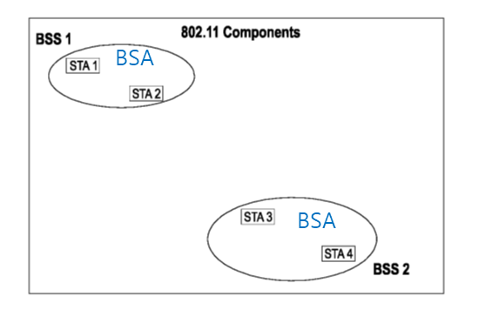
IEEE 802.11-2020 & IEEE 802.11ax-2021 4.3 Components of the IEEE 802.11 architecture 4.3.1 General
3.1 Definitions
Basic service set (BSS):
A set of stations (STAs) that have successfully synchronized using the JOIN service primitives (non-AP STA) and one STA that has used the START primitive (AP STA).
(Mesh BSS) A set of stations (STAs) that that have used the START primitive specifying matching mesh profiles where the match of the mesh profiles has been verified via the scanning procedure.
Membership in a BSS does not imply [that wireless communication with all other members of the BSS is possible].
The basic service set (BSS)
the basic building block of an IEEE 802.11 LAN.

Slide 25
IEEE 802.11-2020 & IEEE 802.11ax-2021 4.3 Components of the IEEE 802.11 architecture 4.3.1 General
3.1 Definitions
basic service area (BSA):
The area containing the members of a basic service set (BSS).
It might contain members of other BSSs.
Basic Service Area (BSA)
The coverage area within which the member STAs of the BSS can remain in communication.
In a directional multi-gigabit (DMG) BSS
The individual coverage area of a transmission from one member STA to another can be thought of as a cone and hence is referred to as a directional transmission.
The collection of all possible directional transmissions by a member STA defines the coverage area.

Slide 26
IEEE 802.11-2020 & IEEE 802.11ax-2021 4.3 Components of the IEEE 802.11 architecture (BSS Type: Infrastructure BSS)
3.1 Definitions
infrastructure:
An infrastructure comprises a distribution system (DS), one or more access points(APs), zero or one portals, and zero or more mesh gates.
It is also the logical location of distribution and integration service functions of an extended service set (ESS).
Infrastructure BSS (No definition in IEEE 802.11-2020)
A BSS in an infrastructure.

Slide 27
IEEE 802.11-2020 & IEEE 802.11ax-2021 4.3 Components of the IEEE 802.11 architecture 4.3.2 Independent BSS (IBSS)
The IBSS is the most basic type of IEEE 802.11 LAN.
This mode of operation is possible when IEEE 802.11 STAs are able to communicate directly.
This type of IEEE 802.11 LAN is often formed without preplanning.
AD HOC mode

Slide 28
IEEE 802.11-2020 & IEEE 802.11ax-2021 4.3 Components of the IEEE 802.11 architecture 4.3.2 Personal BSS (PBSS)
A PBSS can be established only by DMG STAs.
Not every DMG BSS is a PBSS.
A DMG BSS can be a PBSS, an infrastructure BSS, or an IBSS.
One STA assumes the role of the PBSS control point (PCP).
The PCP provides the basic timing for the PBSS through DMG Beacon and Announce frames as well as allocation of service periods and contention based access periods.
The PBSS is a type of IEEE 802.11 LAN in which STAs communicate directly with each other.

Slide 29
IEEE 802.11-2020 & IEEE 802.11ax-2021 4.3 Components of the IEEE 802.11 architecture 4.3.4 STA membership in a BSS is dynamic
A STA’s membership in a BSS is dynamic
STAs turn on, turn off, come within range, and go out of range.
To become a member of an infrastructure BSS or an IBSS,
A STA joins the BSS using the synchronization procedure.
To start a new mesh BSS or to become a member of a mesh BSS,
A STA starts the transmission of Beacon frames and performs (14.13) the synchronization maintenance procedure

Slide 30
IEEE 802.11-2020 & IEEE 802.11ax-2021 4.3 Components of the IEEE 802.11 architecture 4.3.4 STA membership in a BSS is dynamic
To access all of the services of an infrastructure BSS,
A STA becomes “associated.”
These associations are dynamic and involve the use of the distribution system service (DSS)
Changing the serving AP (or the BSS) to another AP in the same ESS
After changing the association, the DSS announce the new serving AP
A mesh STA does not become associated.
There is no central entity in a mesh BSS (MBSS).
Instead, a mesh STA peers with other mesh STAs.

Slide 31
IEEE 802.11-2020 & IEEE 802.11ax-2021 4.3 Components of the IEEE 802.11 architecture 4.3.5 Distribution system (DS) concepts
An infrastructure BSS might form a component of an extended form of network [that is built with multiple BSSs].
The architectural component used to interconnect infrastructure BSSs is the DS for non-general link (non-GLK) operation

Slide 32
IEEE 802.11-2020 & IEEE 802.11ax-2021 4.3 Components of the IEEE 802.11 architecture (Wireless Link Type: General link (GLK))
3.1 Definitions
General link (GLK):
A point-to-point connection between two instances of the IEEE 802.1D Internal Sublayer Service (ISS) that uses an IEEE 802.11 wireless link between stations (STAs).
IEEE 802.1D-2004: Media Access Control (MAC) Bridges (the Ethernet MAC bridge) standard.
A general link is suitable for use in an IEEE 802.1Q bridged network.
IEEE 802.1Q-2018: IEEE Standard for Local and Metropolitan Area Networks - Bridges and Bridged Networks
Currently, IEEE 802.1Q includes IEEE 802.1D
General link (GLK) station (STA):
A STA that implements GLK functionality.

Slide 33
IEEE 802.11-2020 & IEEE 802.11ax-2021 4.3 Components of the IEEE 802.11 architecture 4.3.28 General link (GLK)
EISS (Enhanced ISS)
station_vector parameter
Example of infrastructure BSS with general links
Method-specific service access point (MS SAP):
IEEE 802.11 MA-UNITDATA.request/indication
Internal Sublayer Service (ISS) SAP
- IEEE 802.1AC-2016 M-UNITDATA.request/indication
MAC service access point (MAC SAP)
- IEEE 802.1AC-2016 MA-UNITDATA.request/indication

Slide 34
IEEE 802.11-2020 & IEEE 802.11ax-2021 4.3 Components of the IEEE 802.11 architecture 4.3.5 Distribution system (DS) concepts
The DS and extended service set (ESS) are mechanisms for expanding connectivity for non-GLK operation.
For GLK operation, an IEEE 802.1Q bridge might be used to form an extended network.

Slide 35
IEEE 802.11-2020 & IEEE 802.11ax-2021 4.3 Components of the IEEE 802.11 architecture 4.3.5 Distribution system (DS) concepts
IEEE Std 802.11 logically separates the WM from the distribution system medium (DSM).
The IEEE 802.11 definitions neither preclude, nor demand, that the multiple media be either the same or different.
[Recognizing (that the multiple media are logically different)] is key to understanding the flexibility of the architecture.
The IEEE 802.11 LAN architecture is specified independently of the physical characteristics of any specific implementation.

Slide 36
IEEE 802.11-2020 & IEEE 802.11ax-2021 4.3 Components of the IEEE 802.11 architecture 4.3.5 Distribution system (DS) concepts
The DS enables mobile device support by providing the logical services necessary to handle address to destination mapping and seamless integration of multiple BSSs.
An access point (AP) is any entity that has STA functionality and a distribution system access function (DSAF), which enables access to the DS.
Data move between a BSS and the DS via the DSAF in an AP.
An AP contains a STA and is addressable on the WM using its STA address.
The addresses used by an AP for communication on the WM and on the DSM are not necessarily the same.

Slide 37
IEEE 802.11-2020 & IEEE 802.11ax-2021 4.3 Components of the IEEE 802.11 architecture 4.3.5 Distribution system (DS) concepts
4.3.5.2 Extended service set (ESS): the large coverage network
The DS and infrastructure BSSs allow IEEE Std 802.11 to create a wireless network of arbitrary size and complexity.
IEEE Std 802.11 refers to this type of network as the ESS.
An ESS is the union of the infrastructure BSSs with the same SSID connected by a DS.
The ESS does not include the DS.
The key concept is that the ESS appears the same to an LLC layer as an IBSS.
STAs within an ESS can communicate
STAs might move from one BSS to another (within the same ESS) transparently to LLC.

Slide 38
IEEE 802.11-2020 & IEEE 802.11ax-2021 4.3 Components of the IEEE 802.11 architecture 4.3.5 Distribution system (DS) concepts
4.3.5.2 Extended service set (ESS): the large coverage network
All of the following are possible:
The BSSs partially overlap.
The BSSs could be physically disjoint.
Logically there is no limit to the distance between BSSs.
The BSSs are physically collocated.
One (or more) IBSSs or ESSs are physically present in the same location as one (or more) ESSs.
Some examples are when an IBSS is operating in a location that also has an ESS, when physically overlapping IEEE 802.11 networks have been set up by different organizations, and when two or more different access and security policies are needed in the same location.

Slide 39
IEEE 802.11-2020 & IEEE 802.11ax-2021 4.3 Components of the IEEE 802.11 architecture 4.3.6 Area concepts
For wireless PHYs, well-defined coverage areas simply do not exist.
Propagation characteristics are dynamic and unpredictable.
Small changes in position or direction might produce dramatic differences in signal strength.
Similar effects occur whether a STA is stationary or mobile
While the architecture diagrams show sharp boundaries for BSSs, this is an artifact of the pictorial representation, not a physical reality.
Further description difficulties arise when attempting to describe collocated coverage areas.

Slide 40
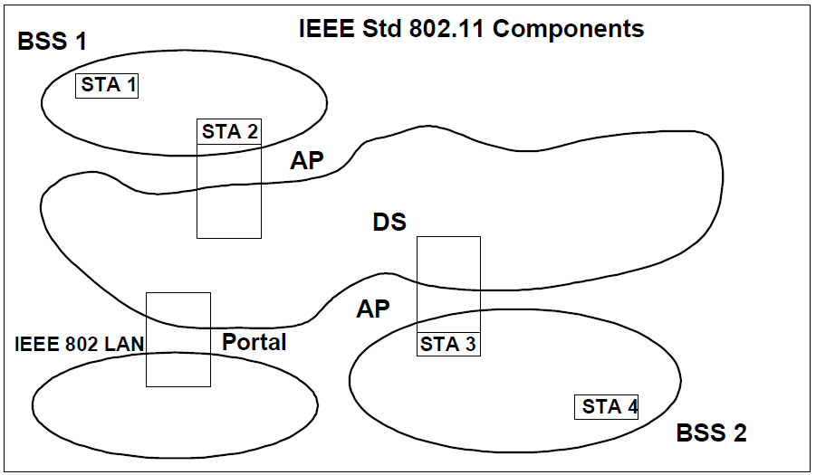
IEEE 802.11-2020 & IEEE 802.11ax-2021 4.3 Components of the IEEE 802.11 architecture 4.3.7 Integration with non-IEEE-802.11 LANs
A portal integrates the IEEE 802.11 non-GLK architecture with a non-IEEE-802.11 LAN, including a traditional wired LAN,
A portal is the logical point at which the integration service is provided.
The integration service is responsible for any addressing changes or other logical mappings that might be required when MSDUs pass between the DS and the integrated LAN.
All data from or to non-IEEE-802.11 LANs enter or leave the IEEE 802.11 architecture via a portal.
It is possible for one device to offer both the functions of an AP and a portal.

Slide 41
IEEE 802.11-2020 & IEEE 802.11ax-2021 4.3 Components of the IEEE 802.11 architecture (BSS Type: Mesh BSS)
3.1 Definitions
Mesh basic service set (MBSS):
A basic service set (BSS) that forms a self-contained network of mesh stations (STAs) that use the same mesh profile.
mesh station (STA):
A quality-of-service (QoS) STA that implements the mesh facility.
mesh profile:
A set of values of parameters that identifies the attributes of the mesh basic service set (MBSS) and that is used in a single MBSS.
mesh facility:
The set of enhanced functions, channel access rules, frame formats, mutual authentication methods, and managed objects used to provide data transfer among autonomously operating stations (STAs) that might not be in direct communication with each other over a single instance of the wireless medium.
An MBSS contains zero or more mesh gates, and can be formed from mesh STAs that are not in direct communication.

Slide 42
IEEE Std 802.11-2020
4. General description
4.3 Components of the IEEE 802.11 architecture
4.3.8 Robust security network association (RSNA)

Slide 43
IEEE 802.11-2020 4.3.8 Robust security network association (RSNA) (the Wi-Fi Alliance: WPA (Wi-Fi Protected Access)
WPA (Wi-Fi Protected Access) is developed by the Wi-Fi Alliance
It is defined to response serious weaknesses in the Wired Equivalent Privacy (WEP) (the default Security Mechanism in IEEE 802.11-1997).
WPA versions
WPA - the Temporal Key Integrity Protocol (TKIP)
WPA2 (2006) – the CCM mode Protocol (CCMP)
CCMP-128 (AES-128 in CCM mode)
WPA3 (2020) – the Galois/counter mode protocol (GCMP),
WPA3-Enterprise mode: AES-256 in GCM mode
GCM: NIST Special Publication 800-38D
WPA3-Personal mode: CCMP-128

Slide 44
IEEE 802.11-2020 & IEEE 802.11ax-2021 4.3 Components of the IEEE 802.11 architecture 4.3.8 Robust security network association (RSNA)
The following features are defined for an RSNA:
Enhanced authentication mechanisms for STAs
Key management algorithms
Cryptographic key establishment
Enhanced data cryptographic encapsulation mechanisms, such as counter mode with cipher-block chaining message authentication code protocol (CCMP), Galois/counter mode protocol (GCMP), and, optionally, temporal key integrity protocol (TKIP)
Fast basic service set (BSS) transition (FT) mechanism
Enhanced cryptographic encapsulation mechanisms for robust Management frames

Slide 45
IEEE 802.11-2020 & IEEE 802.11ax-2021 4.3 Components of the IEEE 802.11 architecture 4.3.8 Robust security network association (RSNA)
An RSNA might rely on components external to the IEEE 802.11 architecture
The first component is an IEEE 802.1X port access entity (PAE).
An AP always implements the Authenticator PAE and Extensible Authentication Protocol (EAP) Authenticator roles,
A non-AP STA always implements the Supplicant PAE and EAP peer roles
In IBSS or PBSS, each STA implements both the Authenticator PAE and Supplicant PAE roles and both EAP Authenticator and EAP peer roles.

Slide 46
IEEE 802.11-2020 & IEEE 802.11ax-2021 4.3 Components of the IEEE 802.11 architecture 4.3.8 Robust security network association (RSNA)
An RSNA might rely on components external to the IEEE 802.11 architecture
A second component is the Authentication Server (AS).
The AS authenticates the elements of the RSNA itself,
The STAs provide material that the RSNA elements use to authenticate each other.
The AS communicates through the IEEE 802.1X Authenticator with the IEEE 802.1X Supplicant on each STA.
(mutual Authentication) The STA authenticates to the AS and vice versa
An RSNA depends upon the use of an EAP method that supports mutual authentication of the AS and the STA

Slide 47
IEEE 802.11-2020 & IEEE 802.11ax-2021 4.3 Components of the IEEE 802.11 architecture 4.3.8 Robust security network association (RSNA)
An RSNA might rely on components external to the IEEE 802.11 architecture
A second component is the Authentication Server (AS).
the IEEE 802.1X Supplicant over a STA – (EAPOL-EAP) – [the IEEE 802.1X Authenticator (relay only)] – (RADIUS/UDP/IP) - AS
IEEE 802.1X 11. EAPOL PDUs (Packet Type: EAPOL-EAP (0000 0000))
RFC3748 Extensible Authentication Protocol (EAP)
RFC5216 The EAP-TLS Authentication Protocol
RFC8446 The Transport Layer Security (TLS) Protocol Version 1.3
RFC2865 Remote Authentication Dial In User Service (RADIUS)
RFC 3579 RADIUS (Remote Authentication Dial In User Service) Support For Extensible Authentication Protocol (EAP)

Slide 48
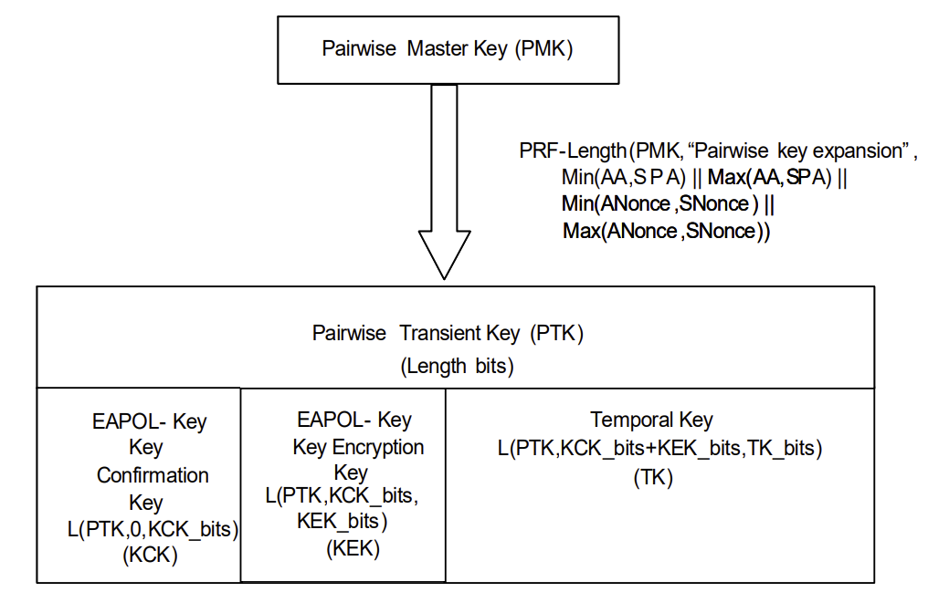
IEEE 802.11-2020 & IEEE 802.11ax-2021 12.7.1 Key hierarchy 12.7.1.3 Pairwise key hierarchy
Figure 12-30—Pairwise key hierarchy

Slide 49
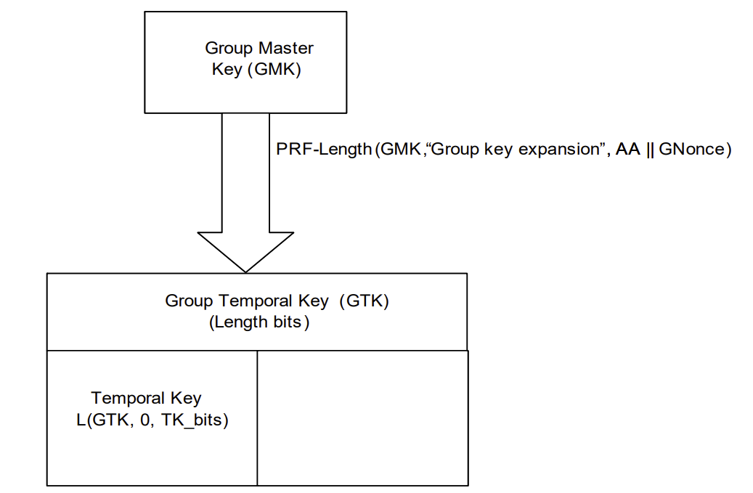
IEEE 802.11-2020 & IEEE 802.11ax-2021 12.7.1 Key hierarchy 12.7.1.4 Group key hierarchy
Figure 12-31—Group key hierarchy

Slide 50
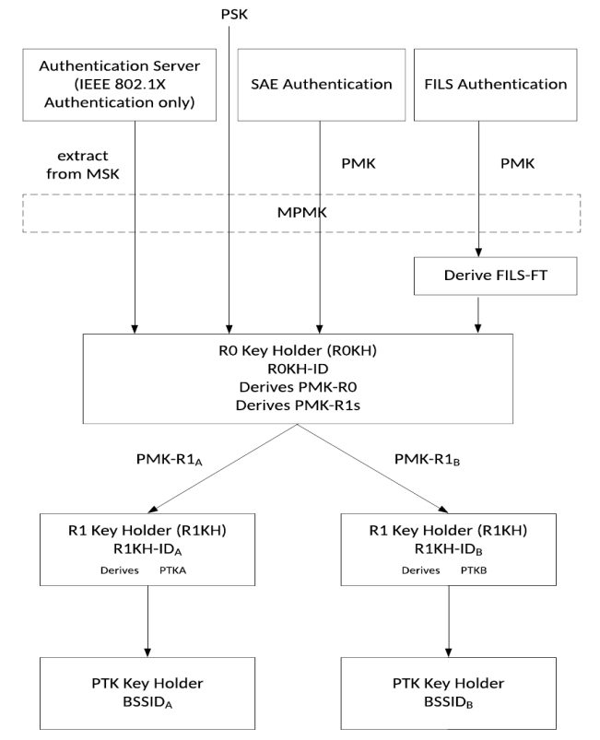
IEEE 802.11-2020 & IEEE 802.11ax-2021 12.7.1 Key hierarchy 12.7.1.6 FT key hierarchy
SAE simultaneous authentication of equals
FILS fast initial link setup
Figure 12-32—FT key hierarchy at an Authenticator

Slide 51
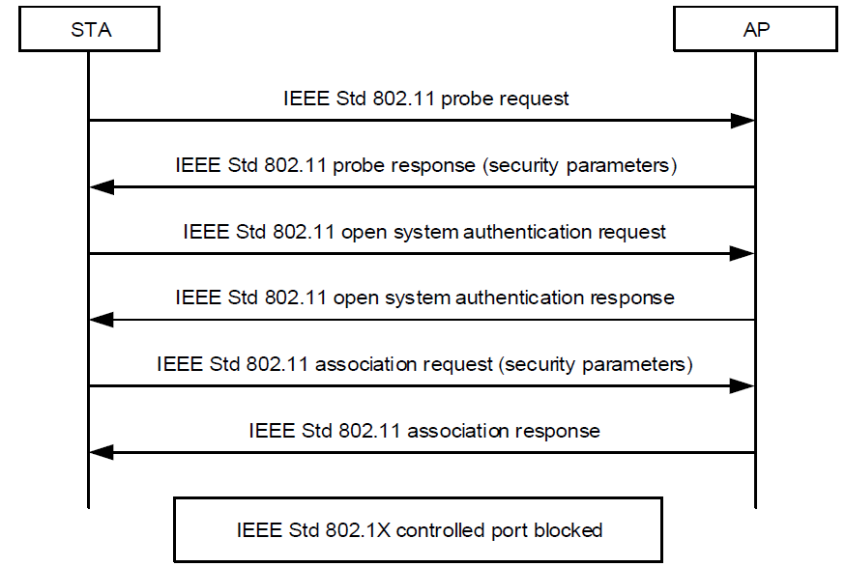
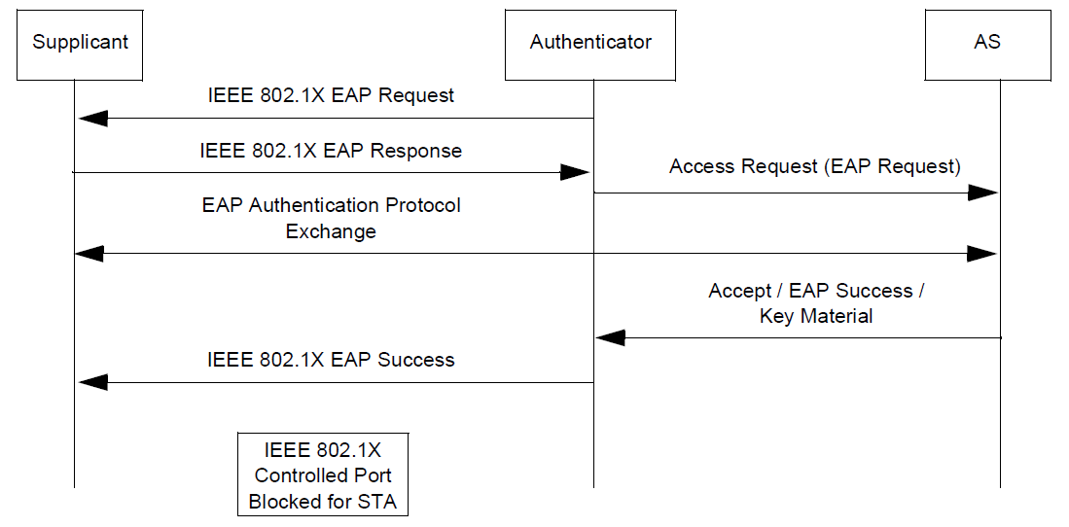
IEEE 802.11-2020 & IEEE 802.11ax-2021 4. General description 4.10 IEEE Std 802.11 and IEEE Std 802.1X-2010
4.10.3.2 AKM operations with AS
KM
PMK
KM
KM
PMK
Figure 4-31—IEEE 802.1X EAP authentication
Figure 4-30—Establishing the IEEE 802.11 association
PMK pairwise master key

Slide 52
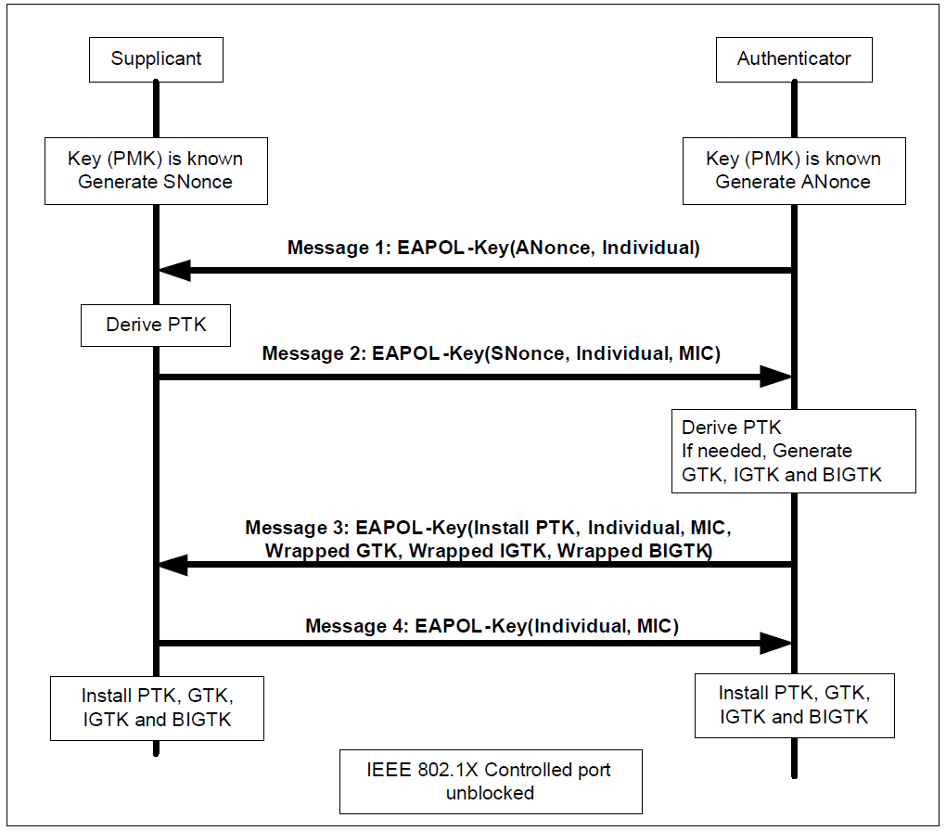
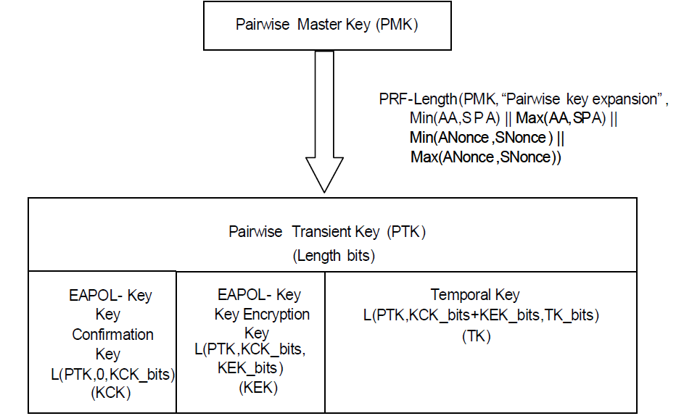
IEEE 802.11-2020 & IEEE 802.11ax-2021 4. General description 4.10 IEEE Std 802.11 and IEEE Std 802.1X-2010
4.10.3.2 AKM operations with AS
Figure 4-32—Establishing pairwise and group keys
4 Way Handshake
KCK
KEK
for CCMP/GCMP

Slide 53
IEEE Std 802.11-2020 & IEEE Std 802.11ax-2021 12. Security 12.2 Framework
12.2.2 Security methods
RSNA security comprises the following algorithms and procedures:
Temporal key integrity protocol (TKIP)
CTR with CBC-MAC protocol (CCMP)
Galois/Counter Mode Protocol (GCMP)
Broadcast/multicast integrity protocol (BIP)
RSNA establishment and termination procedures, including use of IEEE 802.1X authentication
Key management procedures

Slide 54
IEEE Std 802.11-2020 & IEEE Std 802.11ax-2021 12.5 RSNA confidentiality and integrity protocols 12.5.3 CTR with CBC-MAC protocol (CCMP)
All variants of CCMP provides data confidentiality, authentication, integrity, and replay protection.
CCMP is based on the CCM of the AES encryption algorithm.
CCM is defined in IETF RFC 3610.
CCM combines CTR for data confidentiality and CBC-MAC for authentication and integrity.
CCM protects the integrity of both the MPDU Data field and selected portions of the IEEE 802.11 MPDU header.
CCM has two parameters: M(IC) and L(ENGTH).
The AES algorithm is defined in FIPS 197.
AES processing used within CCMP uses AES with either a 128-bit key (CCMP-128 (M=8,L=2)) or a 256-bit key (CCMP-256 (M=16,L=2)).
CCM requires a fresh temporal key for every session.
CCM also requires a unique nonce value for each frame protected by a given temporal key.

Slide 55
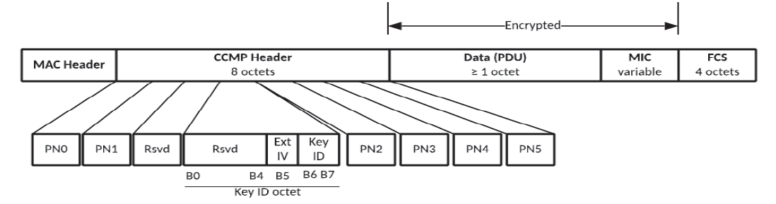
IEEE Std 802.11-2020 & IEEE Std 802.11ax-2021 12.5 RSNA confidentiality and integrity protocols 12.5.3.2 CCMP MPDU format
(1)
Figure 12-16—Expanded CCMP MPDU
For secure PV0 MPDUs,
CCMP-128 processing expands the original MPDU size by 16 octets, 8 octets for the CCMP Header field and 8 octets for the MIC field.
CCMP-256 processing expands the original MPDU size by 24 octets, 8 octets for the CCMP Header field, and 16 octets for the MIC field.
PN is a 48-bit PN represented as an array of 6 octets: [PN5(MSB)..PN0(LSB)].

Slide 56
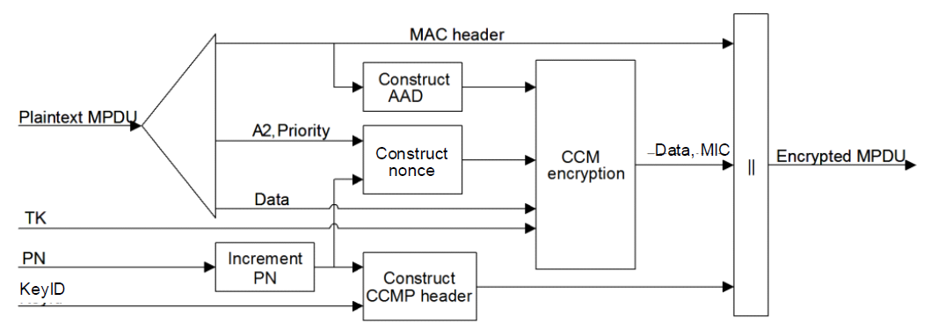
IEEE Std 802.11-2020 & IEEE Std 802.11ax-2021 12.5 RSNA confidentiality and integrity protocols 12.5.3.2 CCMP MPDU format
Figure 12-18—CCMP encapsulation block diagram

Slide 57
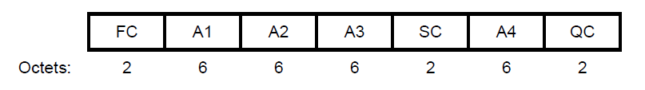
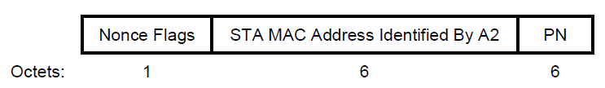
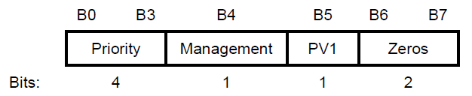
IEEE Std 802.11-2020 & IEEE Std 802.11ax-2021 12.5 RSNA confidentiality and integrity protocols 12.5.3.2 CCMP MPDU format
FC: Frame Control - some subfields are masked
A1,A2,A3,A4: Addresses
SC: Sequence Control - some subfields are masked
QC: QoS Control (Priority) - some subfields are masked
Figure 12-19—AAD construction for PV0 MPDUs
Figure 12-21—Nonce field
Figure 12-22—Nonce Flags subfield

Slide 58
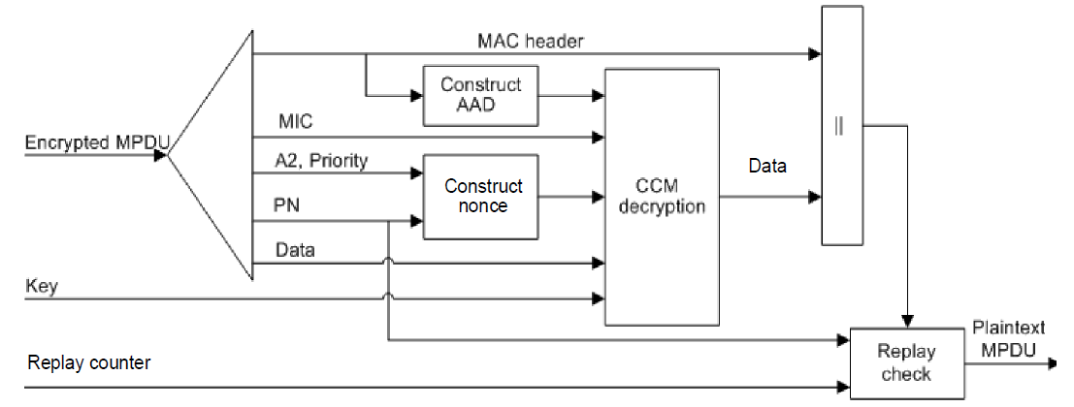
IEEE Std 802.11-2020 & IEEE Std 802.11ax-2021 12.5 RSNA confidentiality and integrity protocols 12.5.3.2 CCMP MPDU format
Figure 12-23—CCMP decapsulation block diagram

Slide 59
IEEE Std 802.11-2020 & IEEE Std 802.11ax-2021 12.5 RSNA confidentiality and integrity protocols 12.5.5 Galois/Counter Mode Protocol (GCMP)
The GCMP provides data confidentiality, authentication, integrity, and replay protection.
GCM is defined in NIST Special Publication 800-38D.
GCMP is based on the GCM of the AES encryption algorithm.
GCM protects the integrity of both the MPDU Data field and selected portions of the MPDU header.
The AES algorithm is defined in FIPS 197.
All AES processing used within GCMP uses AES with a 128-bit key (GCMP-128) or a 256-bit key (GCMP-256).
GCM requires a fresh temporal key for every session.
GCM also requires a unique nonce value for each frame
protected by a given temporal key.
GCMP uses a 128-bit MIC.

Slide 60
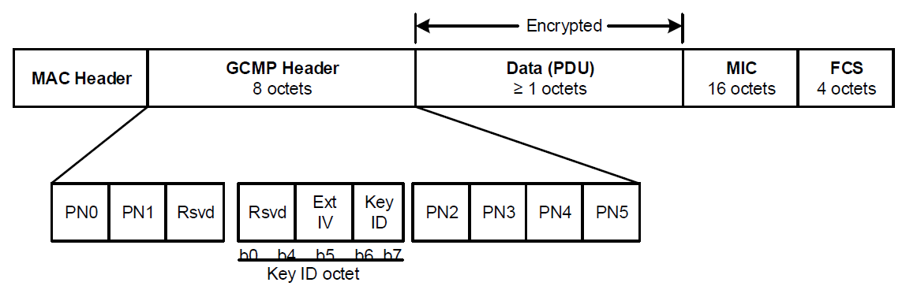
IEEE Std 802.11-2020 & IEEE Std 802.11ax-2021 12.5 RSNA confidentiality and integrity protocols 12.5.5 Galois/Counter Mode Protocol (GCMP)
Figure 12-26—Expanded GCMP MPDU

Slide 61
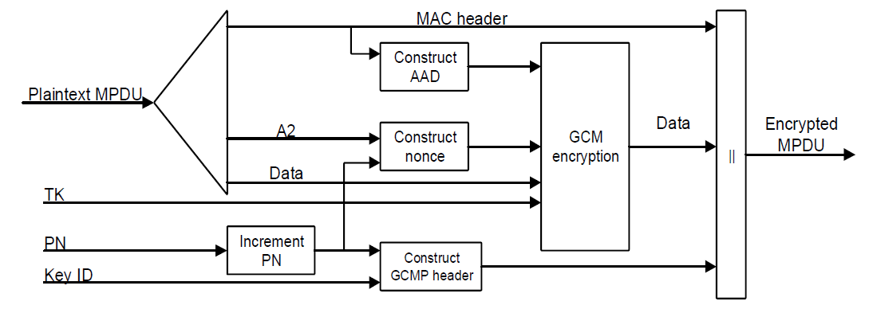

IEEE Std 802.11-2020 & IEEE Std 802.11ax-2021 12.5 RSNA confidentiality and integrity protocols 12.5.5 Galois/Counter Mode Protocol (GCMP)
Figure 12-27—GCMP encapsulation block diagram
Figure 12-28—Nonce field format

Slide 62
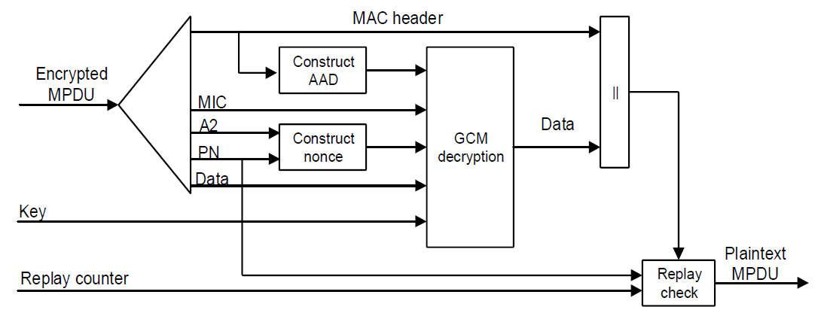
IEEE Std 802.11-2020 & IEEE Std 802.11ax-2021 12.5 RSNA confidentiality and integrity protocols 12.5.5 Galois/Counter Mode Protocol (GCMP)
Figure 12-29—GCMP decapsulation block diagram

Slide 63
CCM VS GCM
CCM (Counter with CBC-MAC)
Message authentication (via CBC-MAC) is done on the plaintext not the ciphertext. (This is generally not a desireable feature.)
On the encrypt operation, the encryption and MAC could happen in parallel, but generally do not (typically because there is just one AES engine in a chip, just one AES thread at a time, etc.). Similar statement is true for decrypt.
Performance costs essentially 2 x AES operations per block
Cannot be parallelized
GCM (Galois Counter Mode)
Message authentication (via GMAC/GHASH) is done on the ciphertext. (This is desirable most of the time.)
Note that in most implementations, the auth check and decryption happen in parallel for performance reasons.
Performance costs 1 x AES operation and 1 x GHASH per block (GHASH generally faster than AES, so GCM is faster)
Encrypt/decrypt of multiple blocks can be parallelized nicely
GCM should be considered superior to CCM for most applications that require authenticated encryption. Because of the authentication that happens, GCM is not susceptible to the bit flipping and other attacks that can be mounted against counter mode or other stream modes.
https://crypto.stackexchange.com/questions/6842/how-to-choose-between-aes-ccm-and-aes-gcm-for-storage-volume-encryption

